Slide 1
Data Engineering 2.0
We AreDevs |14.06.2022
Let's build a simple Data Pipeline using Singer.io

Slide 2
Agenda
We AreDevs |14.06.2022
Intro (5 min)
What is Data Engineering? (10 min)
What will we do? (50 min)
What would be next steps? (10 min)
Questions (15 min)

Slide 3
Agenda
We AreDevs |14.06.2022
Intro (5 min)
About me (1 min)
My company (1 min)
Topic of the workshop (3 min)
What is Data Engineering? (10 min)
What will we do? (50 min)
What would be next steps? (10 min)
Questions (15 min)

Slide 4





About me
We AreDevs |14.06.2022
Bachelor degree in Business Informatics – Software Engineering
Master‘s degree in Business Informatics – Big Data
~ 3 Years SAP development
~ 1,5 Year Data Engineer
Data Team organized as Circle (decentral)
Core Team: 6 Members
Total of about 17 Data members
Michel Ebner
Data Engineer
https://www.linkedin.com/in/michel-ebner/

Slide 5

Accounting in the Cloud
Notes:
SaaS Company
Cloud accounting for micro and small businisses

Slide 6
Topic of the workshop
We AreDevs |14.06.2022
What is Data Engineering? Why is it related to Software development?
What’s a data pipeline?
Data Engineering 2.0 - Let's build a simple Data Pipeline using Singer.io
Why 2.0? Did I miss 1.0? What was it before? What is the next version?
What is Singer.io? Why use this? Are there other frameworks?
https://www.linkedin.com/in/michel-ebner/

Slide 7
Agenda
We AreDevs |14.06.2022
Intro (5 min)
What is Data Engineering? (10 min)
What will we do? (50 min)
What would be next steps? (10 min)
Questions (15 min)

Slide 8
Agenda
We AreDevs |14.06.2022
Intro (5 min)
What is Data Engineering? (10 min)
Definition (2 min)
Where we came from (5 min)
What will we do? (50 min)
What would be next steps? (10 min)
Questions (15 min)

Slide 9
Definition
Definition of different Data Engineering terms

Slide 10
What is Data Engineering
We AreDevs |14.06.2022
“As a professional, the engineer prepares the structure to host the data. His job is similar in some ways to that of a software engineer, as he designs and builds and then integrates the company's data.” - Oracle
“A data engineer is an IT worker whose primary job is to prepare data for analytical or operational uses.” - TechTarget
“Data engineering is the process of designing and building systems that let people collect and analyze raw data from multiple sources and formats.” - Dremio
“Data engineering is the practice designing and building systems for collecting, storing, and analyzing data at scale.” - Cousera

Slide 11
What is Data Engineering
We AreDevs |14.06.2022
Process of building data pipelines to ingest necessary data for analysts and scientist
Notes:
Now this is still very vague. What’s part of a data engineers' job? Well that depends (as usual). It depends on the team size, structure and process. The main question is: is it ELT or ETL? In my case, we use ELT and I am responsible for following parts: - Data Extraction - Data Loading - Infrastructure - Build and deploy
Now you may wonder? What is ELT or ETL or the other specific words? Let me explain some of them and if I use one during the workshop, interrupt me and I will explain it.

Slide 12
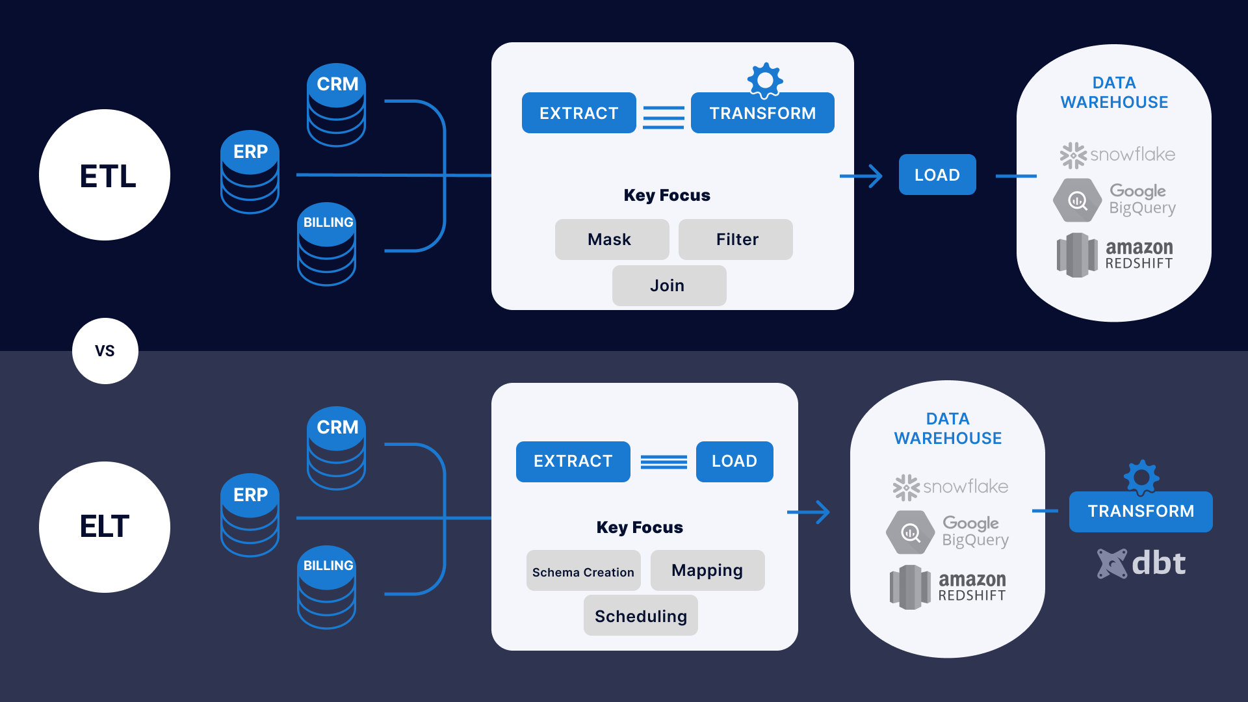
Other definitions: ETL vs. EL(T)
We AreDevs |14.06.2022
E: Extract L: Load T: Transform
Source: https://www.striim.com/blog/etl-vs-elt-2/

Slide 13
Where did we come from?
A brief look into the History of Data Pipelines to understand how and why we do it now as we do it

Slide 14






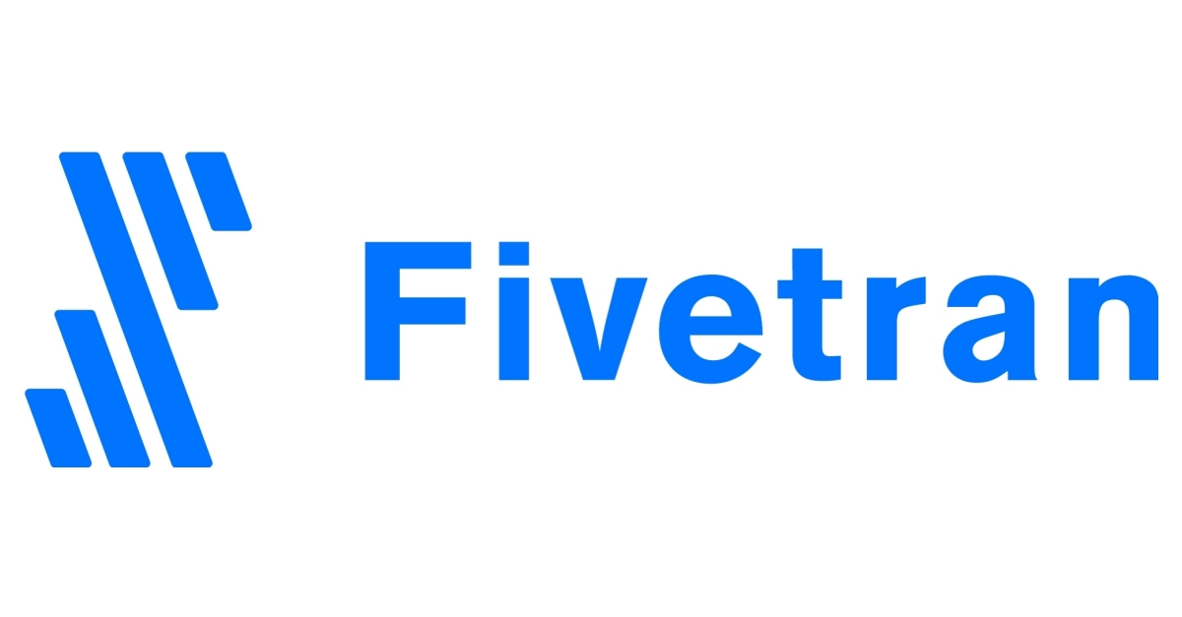
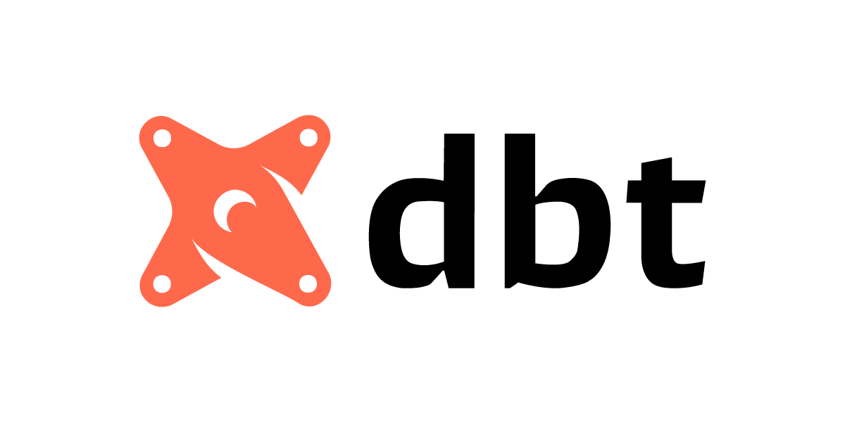

Data Pipeline Timeline
We AreDevs |14.06.2022
2004
2011
2016
2019
Before
2006
2014
2018
Notes:
Before: absence of real big data processing methods. Copy data from a source to a target and gather all in one place
2004 was a first big breakthrough by Jeff Dean and Sanjay Ghemawat regarding data processing on large clusters : MapReduce was created at Google
Hadoop quickly got onto the train and wrote an open source implementation of MapReduce which was published in 2006
2008
2011
2014
2016
2018
2019
Today we have many tools
How? data driven thinking, cloud, Technology

Slide 15
Agenda
We AreDevs |14.06.2022
Intro (5 min)
What is Data Engineering? (10 min)
What will we do? (50 min)
Goal (2 min)
How to use singer.io (8 min)
Less Bullshit, More Engineering (40 min)
What would be next steps? (10 min)
Questions (15 min)

Slide 16

Goal

Slide 17


Goal
We AreDevs |14.06.2022
Get data from NASA API as csv:
List of all Asteroids → Full Table sync
Get details of all Asteroids → Sync with dependency
Get closest Asteroid per Day (00:00) → Incremental sync

Slide 18

Hot to use Singer.io

Slide 19
Agenda
We AreDevs |14.06.2022
Intro (5 min)
What is Data Engineering? (10 min)
What will we do? (50 min)
Goal (2 min)
How to use singer.io (8 min)
Less Bullshit, More Engineering (40 min)
What would be next steps? (10 min)
Questions (15 min)

Slide 20
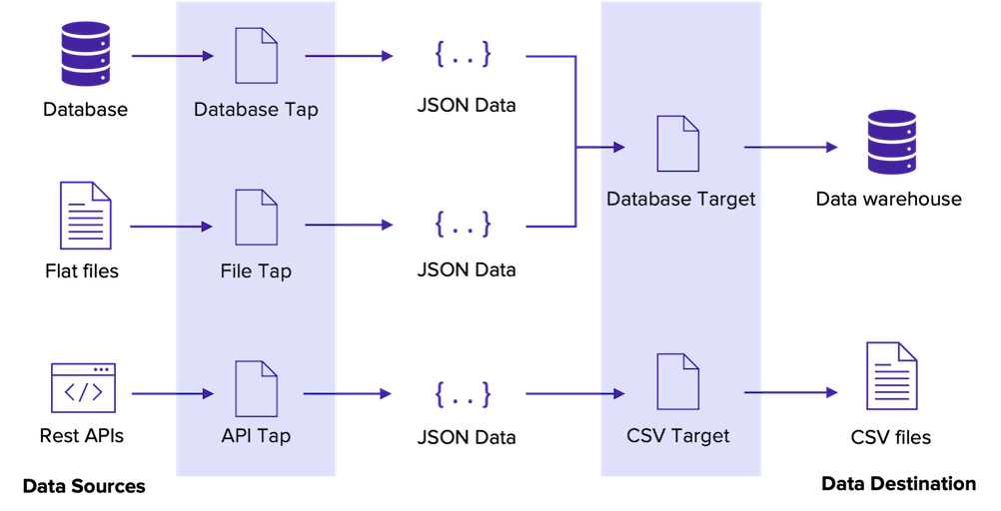
Singer Basics I
We AreDevs |14.06.2022
Open source standard to move data
Extraction scripts → Taps
Loading scripts → Targets
Communicate using JSON data over stdout
Taps and Targets can be used in combination to move data

Slide 21
Singer Basics
We AreDevs |14.06.2022
Source: https://blog.panoply.io/etl-with-singer-a-tutorial

Slide 22
Singer Basics II
We AreDevs |14.06.2022
Input
- Config
- State
- Catalog
- (Discover)
- tap --config CONFIG [--state STATE] [--catalog CATALOG]
Output
- RECORD Message
- SCHEMA Message
- STATE Message
Notes:
CONFIG is a required argument that points to a JSON file containing any configuration parameters the Tap needs.
STATE is an optional argument pointing to a JSON file that the Tap can use to remember information from the previous invocation, like, for example, the point where it left off.
CATALOG is an optional argument pointing to a JSON file that the Tap can use to filter which streams should be synced.
RECORD messages contain the data from the data stream.
SCHEMA messages describe the datatypes of data in the stream.
STATE messages contain the state that the Tap wishes to persist.

Slide 23
Less bullshit, more engineering!

Slide 24
Tasks
We AreDevs |14.06.2022
Setup + Hello World
Explore the NASA API
First simple script for Full Table
Refactor – init, client, sync, stream
Dependent stream
Incremental Stream
Rate Limit, Periodic load, Backoff…

Slide 25
Tasks
We AreDevs |14.06.2022
Setup + Hello World
Explore the NASA API
First simple script for Full Table
Refactor – init, client, sync, stream
Dependent stream
Incremental Stream
Rate Limit, Periodic load, Backoff…

Slide 26
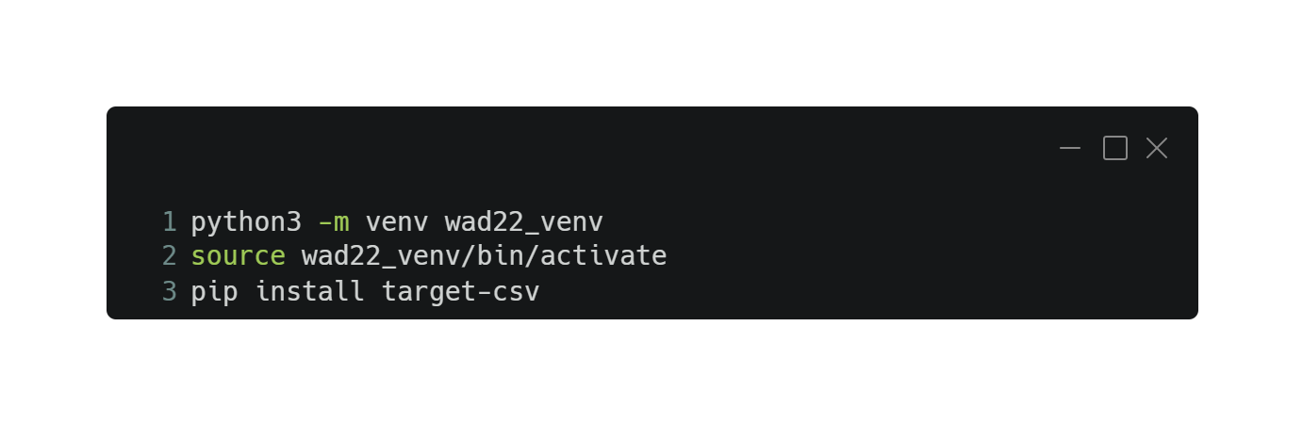
Setup virtual environment
We AreDevs |14.06.2022

Slide 27
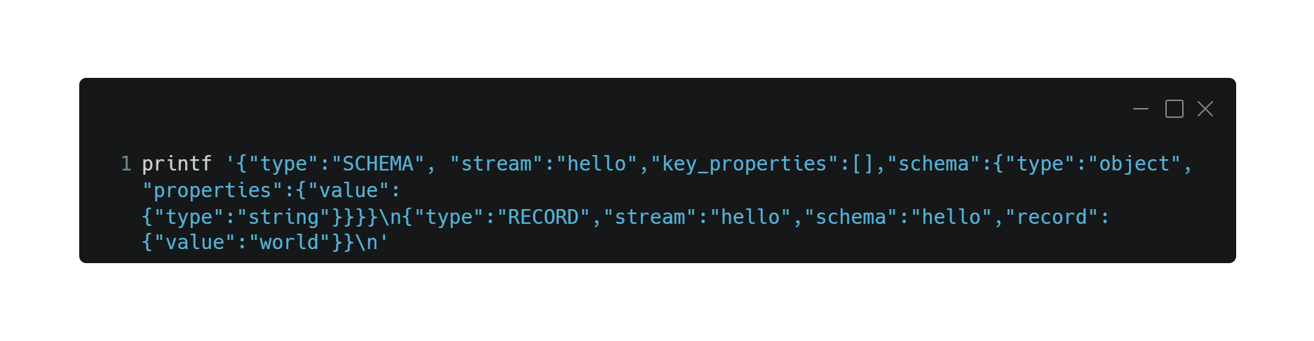
Singer Hello World
We AreDevs |14.06.2022

Slide 28
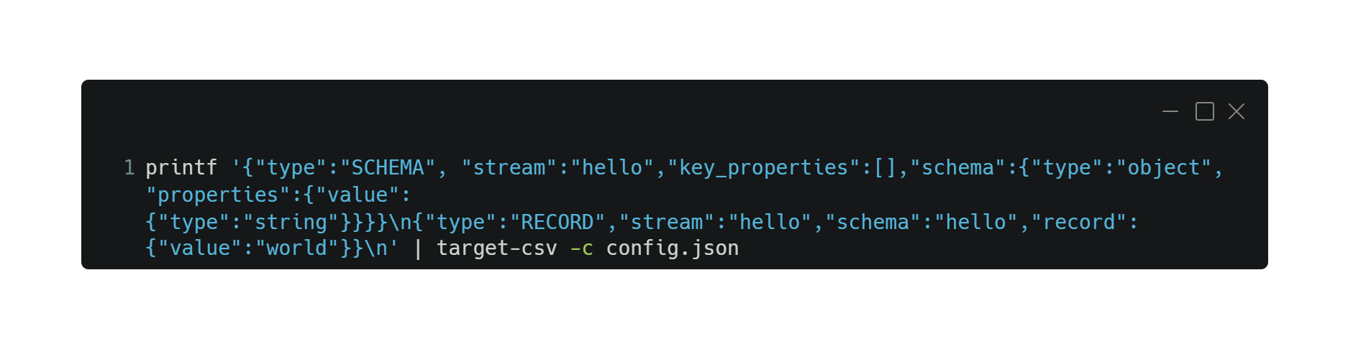
Singer Hello World
We AreDevs |14.06.2022

Slide 29
Tasks
We AreDevs |14.06.2022
Setup + Hello World
Explore the NASA API
First simple script for Full Table
Refactor – init, client, sync, stream
Dependent stream
Incremental Stream
Rate Limit, Periodic load, Backoff…

Slide 30
Tasks
We AreDevs |14.06.2022
Setup + Hello World
Explore the NASA API
First simple script for Full Table
Refactor – init, client, sync, stream
Dependent stream
Incremental Stream
Rate Limit, Periodic load, Backoff…

Slide 31
Explore the NASA API
We AreDevs |14.06.2022
Get your API Key! Will be used as parameter (api_key) in each request.
List of all Asteroids:
https://api.nasa.gov/neo/rest/v1/neo/browse
Details of Asteroid with ID:
https://api.nasa.gov/neo/rest/v1/neo/<ID> (ex: 3542519)
List of closest Asteroids by date:
https://api.nasa.gov/neo/rest/v1/feed?start_date=2015-09-07&end_date=2015-09-07
https://api.nasa.gov/

Slide 32
Tasks
We AreDevs |14.06.2022
Setup + Hello World
Explore the NASA API
First simple script for Full Table
Refactor – init, client, sync, stream
Dependent stream
Incremental Stream
Rate Limit, Periodic load, Backoff…

Slide 33
Tasks
We AreDevs |14.06.2022
Setup + Hello World
Explore the NASA API
First simple script for Full Table
Refactor – init, client, sync, stream
Dependent stream
Incremental Stream
Rate Limit, Periodic load, Backoff…

Slide 34
Tasks
We AreDevs |14.06.2022
Setup + Hello World
Explore the NASA API
First simple script for Full Table
Refactor – init, client, sync, stream
Dependent stream
Incremental Stream
Rate Limit, Periodic load, Backoff…

Slide 35
Tasks
We AreDevs |14.06.2022
Setup + Hello World
Explore the NASA API
First simple script for Full Table
Refactor – init, client, sync, stream
Dependent stream
Incremental Stream
Rate Limit, Periodic load, Backoff…

Slide 36
Tasks
We AreDevs |14.06.2022
Setup + Hello World
Explore the NASA API
First simple script for Full Table
Refactor – init, client, sync, stream
Dependent stream
Incremental Stream
Rate Limit, Periodic load, Backoff…

Slide 37
Tasks
We AreDevs |14.06.2022
Setup + Hello World
Explore the NASA API
First simple script for Full Table
Refactor – init, client, sync, stream
Dependent stream
Incremental Stream
Rate Limit, Periodic load, Backoff…

Slide 38
Tasks
We AreDevs |14.06.2022
Setup + Hello World
Explore the NASA API
First simple script for Full Table
Refactor – init, client, sync, stream
Dependent stream
Incremental Stream
Rate Limit, Periodic load, Backoff…

Slide 39
Tasks
We AreDevs |14.06.2022
Setup + Hello World
Explore the NASA API
First simple script for Full Table
Refactor – init, client, sync, stream
Dependent stream
Incremental Stream
Rate Limit, Periodic load, Backoff…

Slide 40
Tasks
We AreDevs |14.06.2022
Setup + Hello World
Explore the NASA API
First simple script for Full Table
Refactor – init, client, sync, stream
Dependent stream
Incremental Stream
Rate Limit, Periodic load, Backoff…

Slide 41
Tasks
We AreDevs |14.06.2022
Setup + Hello World
Explore the NASA API
First simple script for Full Table
Refactor – init, client, sync, stream
Dependent stream
Incremental Stream
Rate Limit, Periodic load, Backoff…

Slide 42
Agenda
We AreDevs |14.06.2022
Intro (5 min)
What is Data Engineering? (10 min)
What will we do? (50 min)
What would be next steps? (10 min)
How does an entire modern Data Tech Stack look like? (5 min)
What will be the role of a Data Engineer in the future? (5 min)
Questions (15 min)

Slide 43
How does an entire modern Data Tech Stack look like?
Our Tech Stack

Slide 44
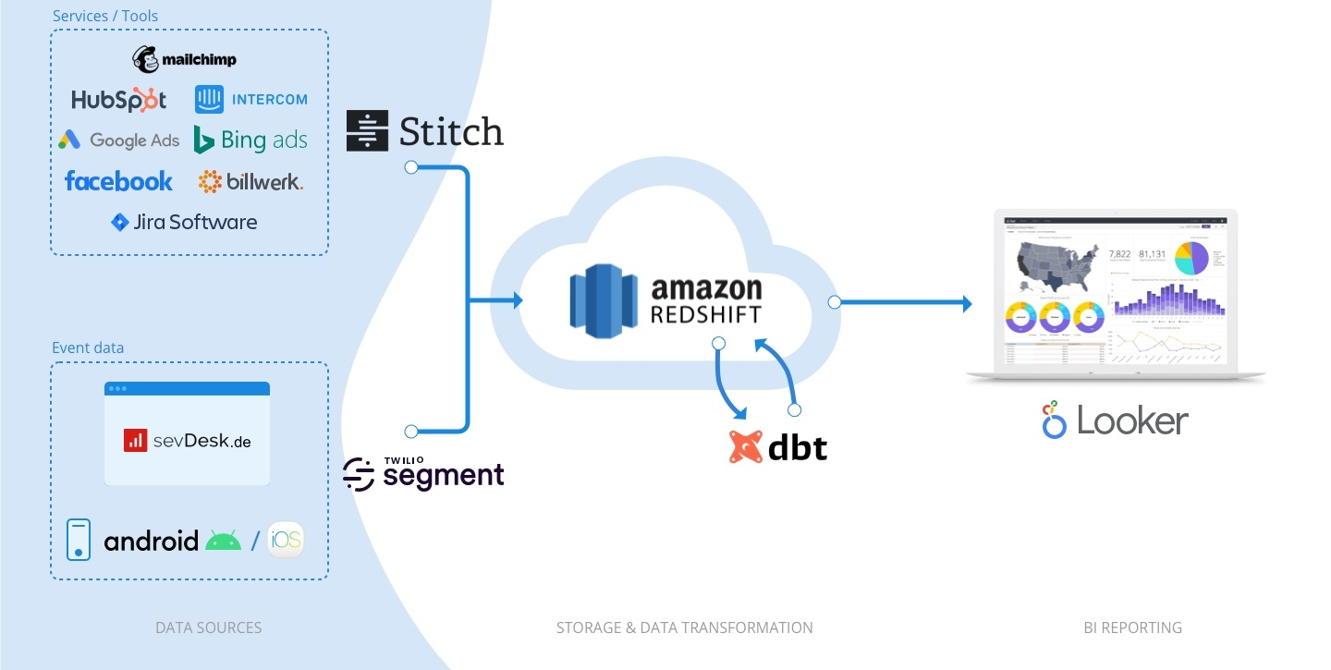
sevDesk Data Tech Stack 2021

Slide 45
How does an entire modern Data Tech Stack look like?
What‘s out there?

Slide 46
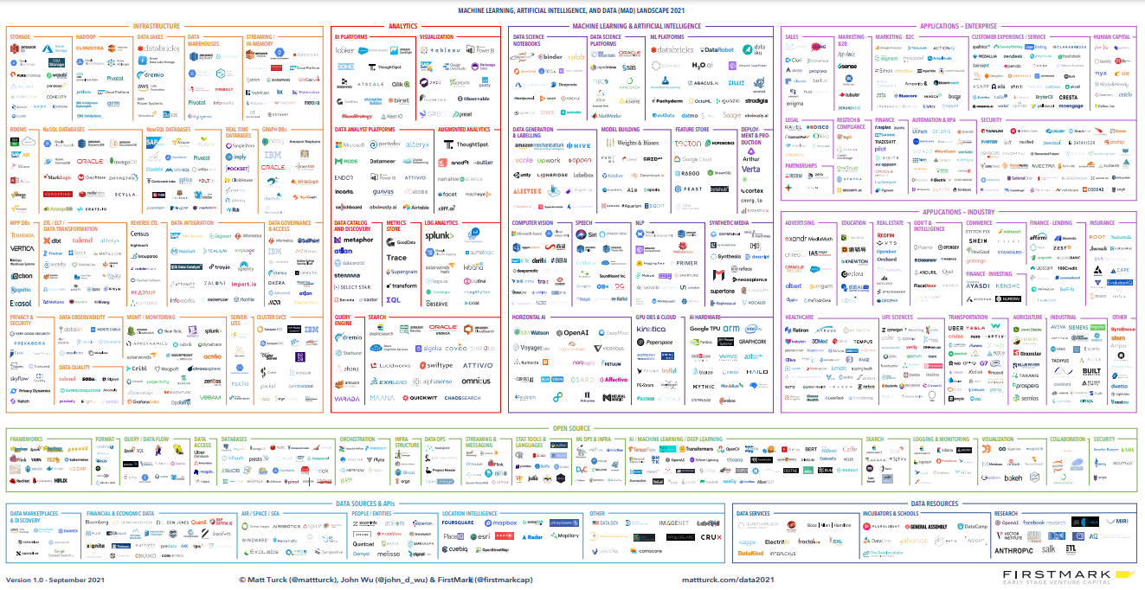
Data Tool-Landscape 2021

Slide 47
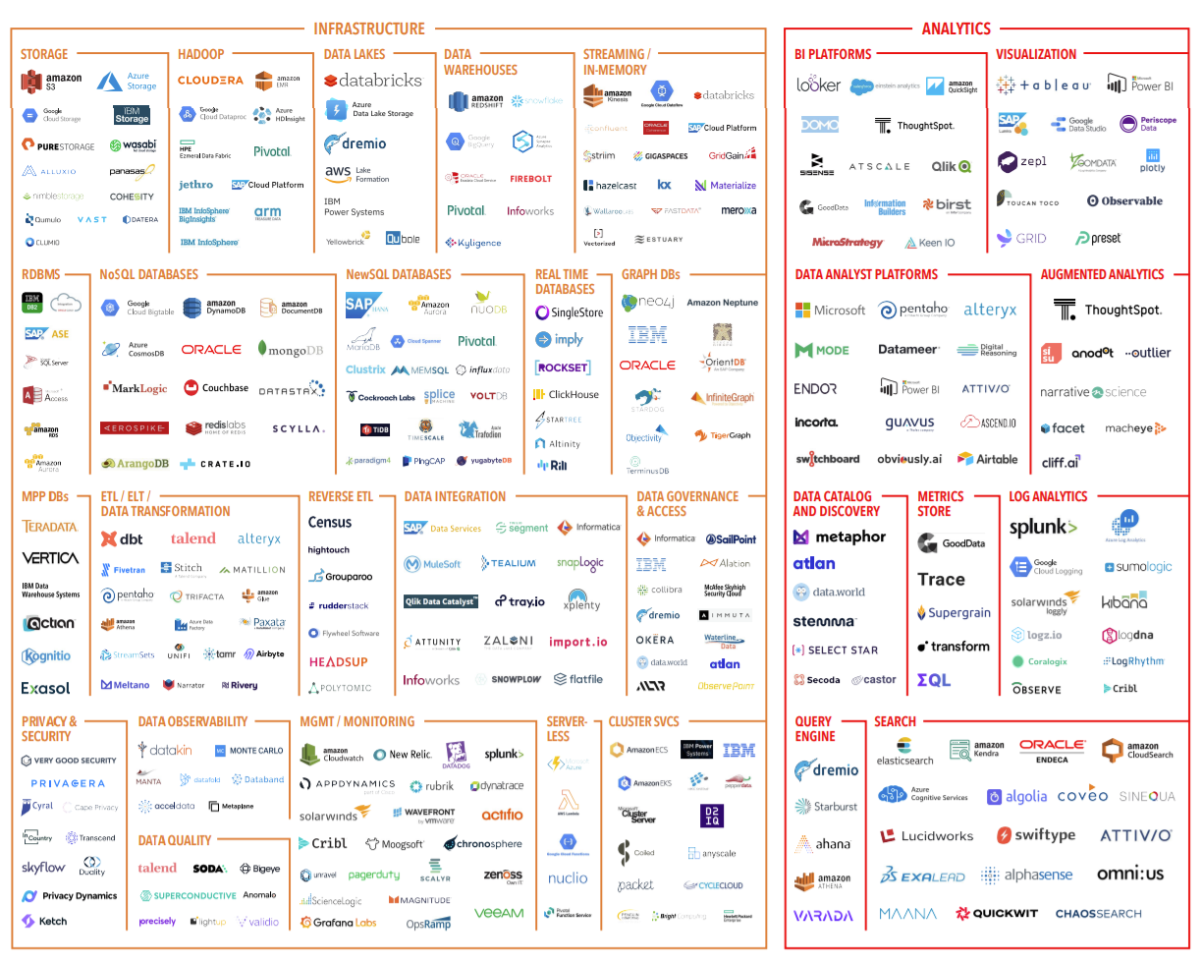
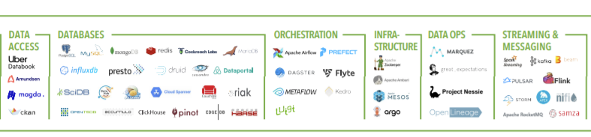
Data Tool-Landscape 2021

Slide 48

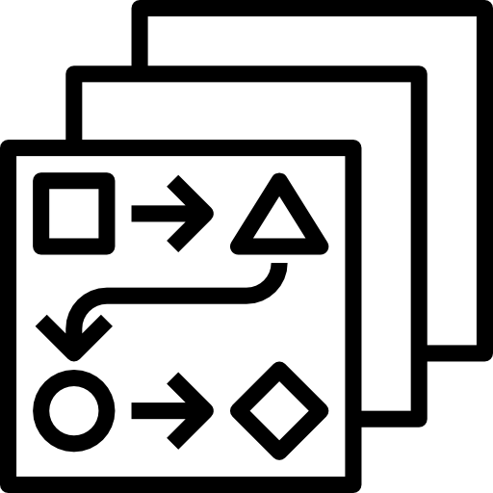




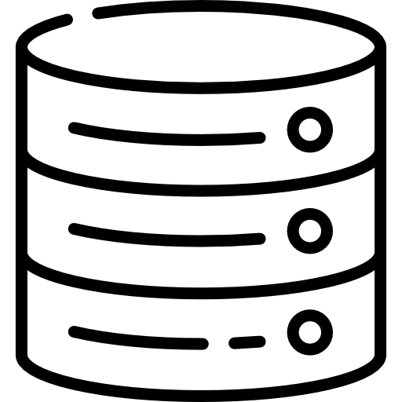






Modern Data Stack
Product
Transform
Dashboards
Events
Visualize
Data Warehouse
Governance
Databases
Extract / Load
Sync (Reverse ELT)
Tools
Orchestration

Slide 49
What will be the role of a Data Engineer in the future?
Data Platform Engineer

Slide 50
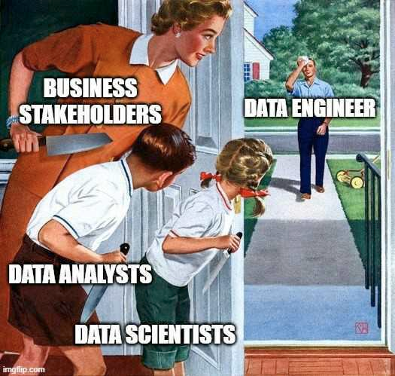
What is a Data Engineer?
Data Engineering Infrastructure
Notes:
Easy: Software engineer with data specification
Real: solution oriented engineer for data. build infra, build pipeline, Extract data. The transform is not even that big of its role anymore.

Slide 51
What is a Data Engineer?
Data Engineering Infrastructure
Data Infrastructure
- Data Warehouse
- EL Tool
- T Tool
- Reverse ELT Tool
- Orchestration Tool
Custome Extractors
Data Governance (Accessibility, security/privacy)
Integrat all tools to get a pipeline
Setup CI/CD -> DataOps
Want to know more: https://groupby1.substack.com/p/data-engineering
Notes:
Easy: Software engineer with data specification
Real: solution oriented engineer for data. build infra, build pipeline, Extract data. The transform is not even that big of its role anymore.

Slide 52
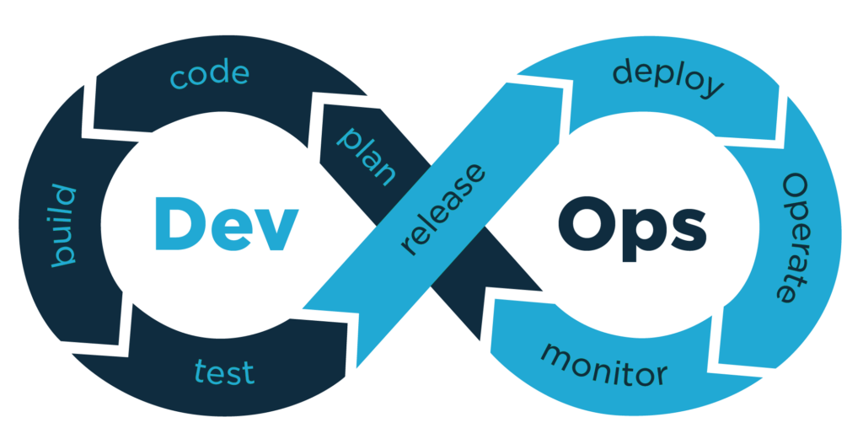
Data EL DevOps Tech Stack
Data Engineering Infrastructure
Data

Slide 53
















Data EL DevOps Tech Stack
Data Engineering Infrastructure
Issues
Requests
Develop, debug and test local
Commit and push code
Deploy to K8s using Fleet
Data
Build within CI
Use Console
Review Application Logs
Use Prometheus + Pushgateway
View metrics within Grafana
Get notified in Slack by Grafana Alerts
Manual Tests
Meltano (Beta)
Pytest (Beta)
Merge request
Semantic release
Notes:
This is all part of my job!
Is it because I am the lone data engineer? Probably
Should it be? For me yes, it makes my job so exciting
As you see it is close to a software engineer. But you think data, not feature!

Slide 54

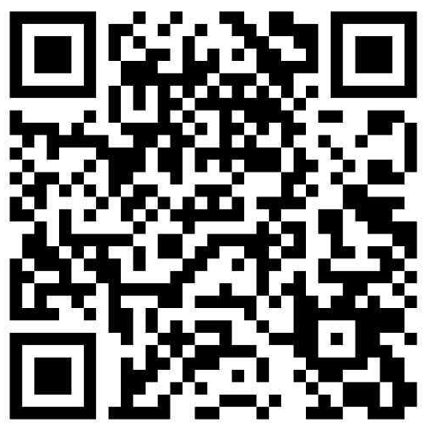
Any questions?
Michel Ebner
Data Engineer
michel.ebner@sevdesk.de
Locally Optimistic
Singer
Meltaon
Notes:
SaaS Company
Cloud accounting for micro and small businisses

